Slide 1
Customer Segmentation Using Clustering
Identifying distinct customer groups based on Spending Score and Demographic Features.
By DSI Data Science team 2
Miguel
Sanyam
Preethi
Harris
Olena
Emilia

Slide 2
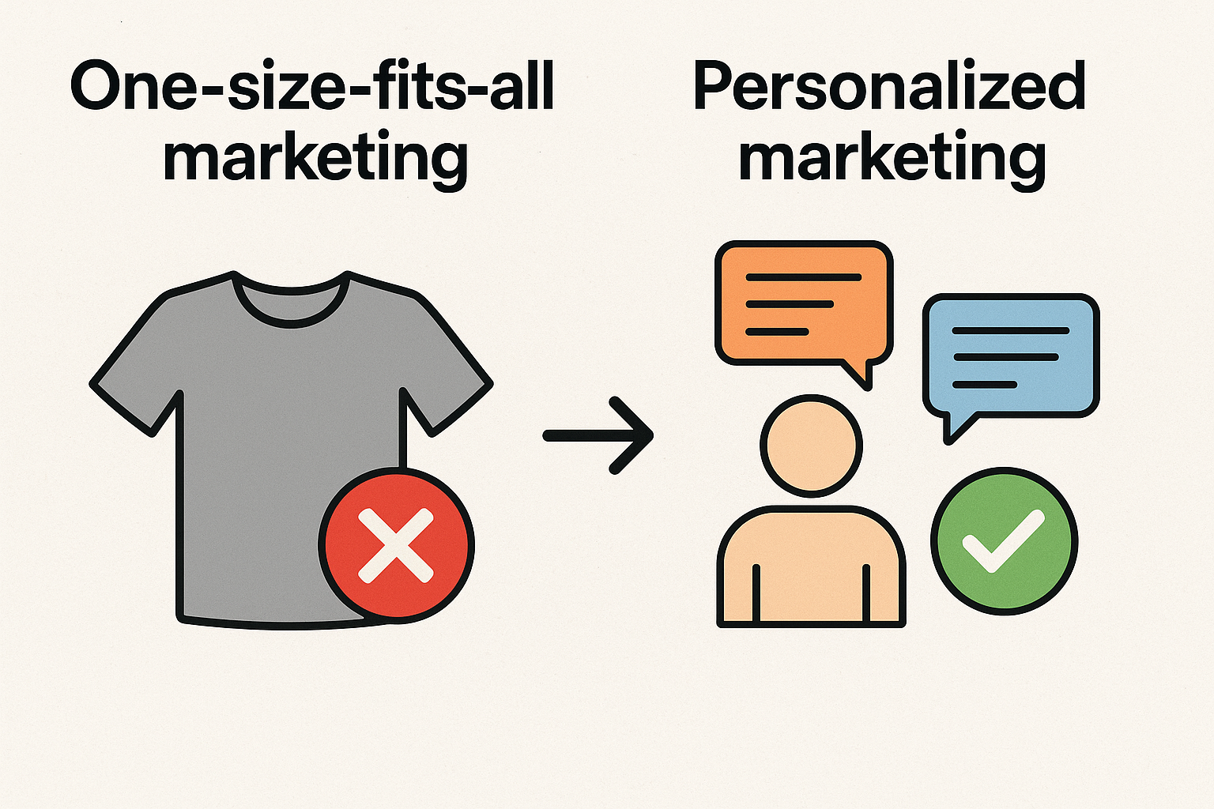
Business Context
Retail companies collect large amounts of customer data but struggle to understand diverse customer behaviors. Treating all customers the same, leads to ineffective marketing strategies.
Customer segmentation helps in identifying group of customers with similar characteristics for tailored offers and marketing campaigns, which in turn leads to higher ROI, customer loyalty, and profitability.

Slide 3
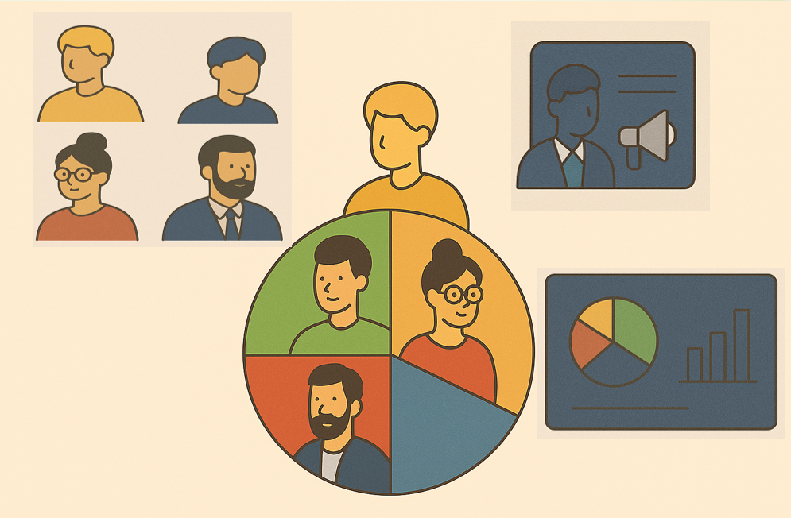
Project Objective
Group customers using data analysis techniques based on demographics and spending.
Understand the characteristics of each segment/cluster (age range, profession, spending pattern, etc.).
Identify customer into 3 clusters: high-value, budget-conscious, and mid-range.
Use insights to help the business in decision-making and design personalized marketing campaigns for each segments.

Slide 4
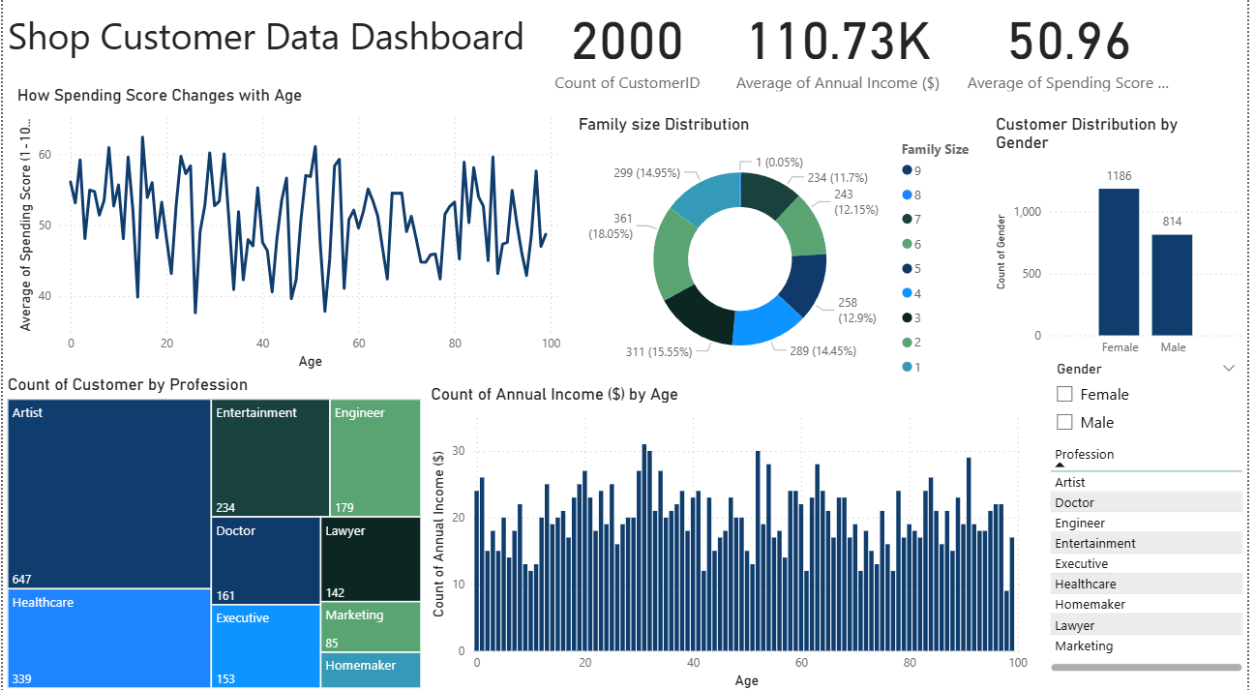
Technical Stack
Dataset Overview
Programming Language: Python
Environment: Jupyter Notebook
Libraries Used:
Numpy: matrix operations
Pandas: data analysis
Matplotlib: creating graphs and plots
Seaborn: enhancing matplotlib plots
SKLearn: regression analysis
Source: Kaggle — Shop Customer Dataset

Slide 5
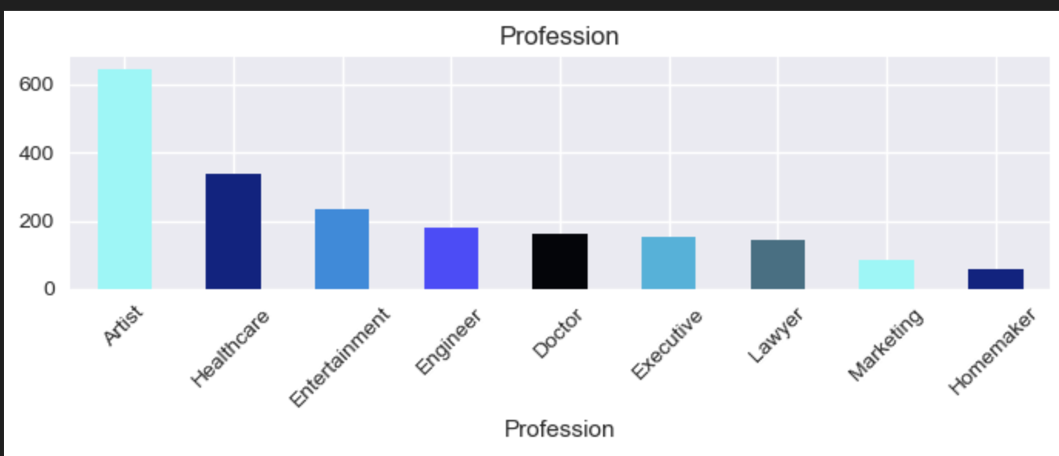
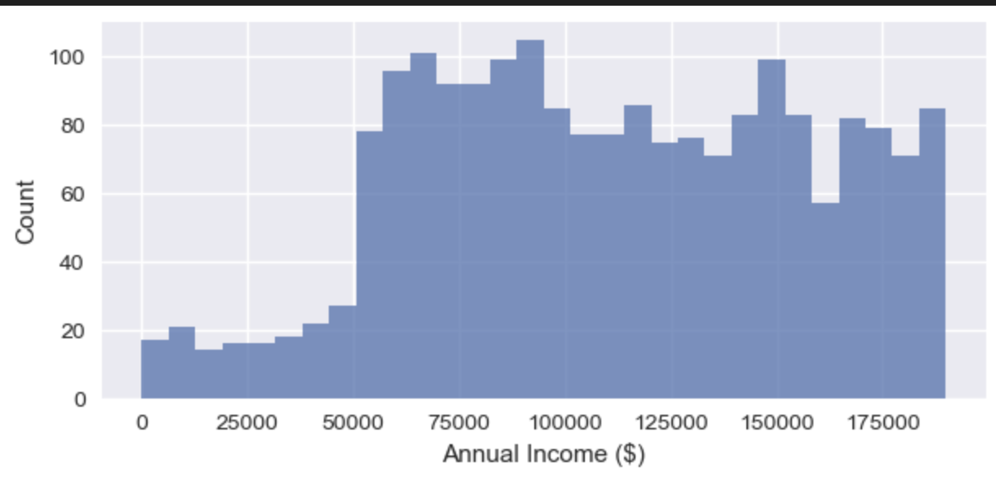
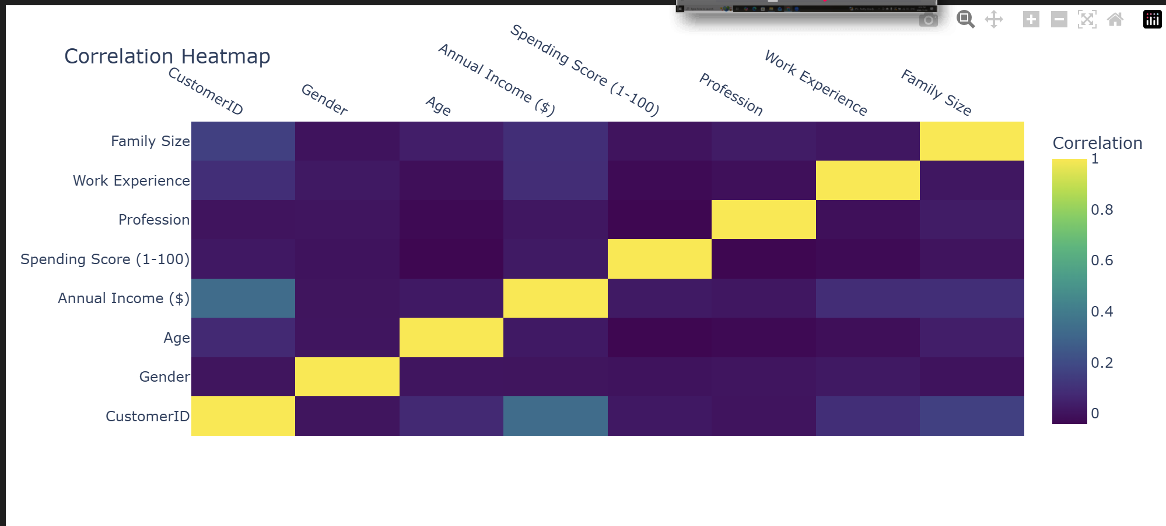
Exploratory Data Analysis
1
2
3
Notes:
On the left, we see the distribution of professions, where artists and healthcare workers make up the largest groups.
On the right, the income histogram shows a wide but slightly right-skewed distribution.
Finally, the correlation heatmap at the bottom helps us identify relationships between variables, such as the strong correlations along the diagonal and weaker relationships among demographic features. so this chart tells us the correlation is very weak.

Slide 6
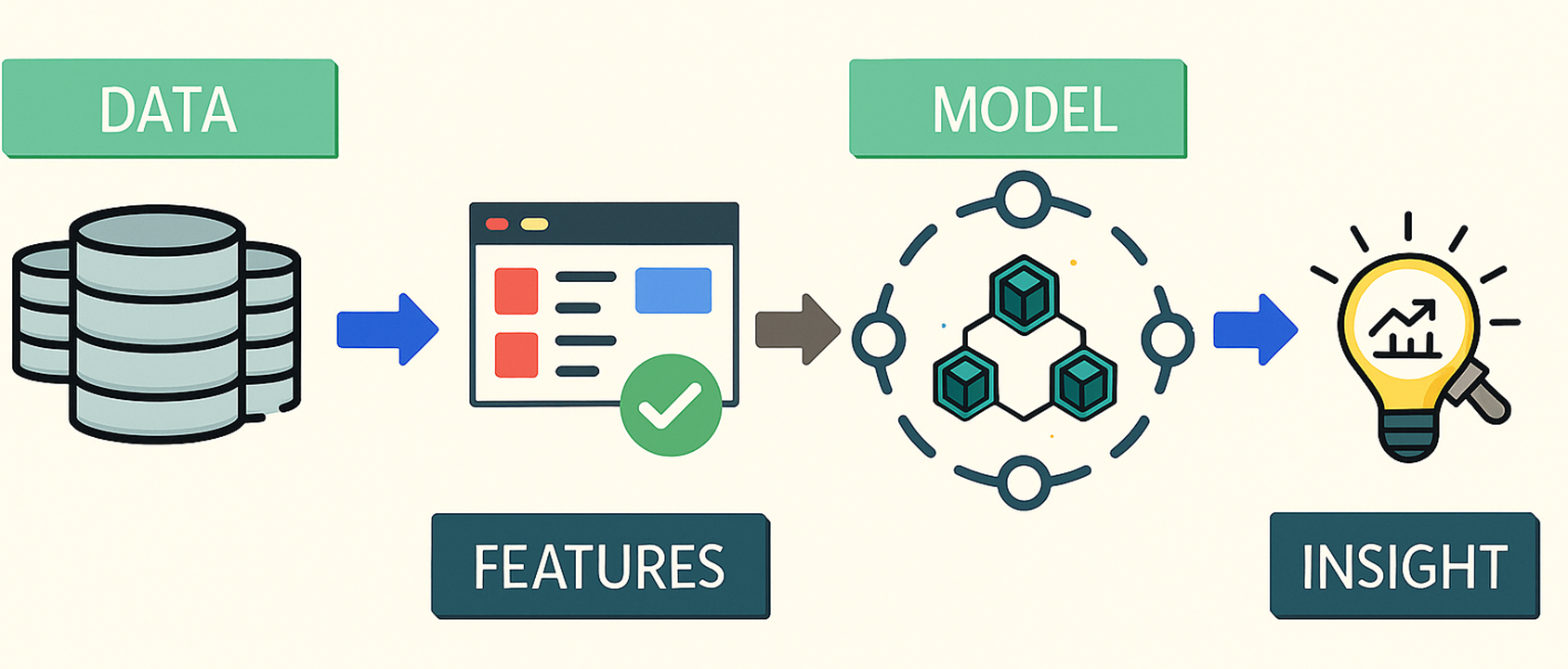
Feature Engineering
Features considered are: Age, Gender,Profession, Family Size, Annual Income ($), Spending Score (1-100), Work Experience

Slide 7
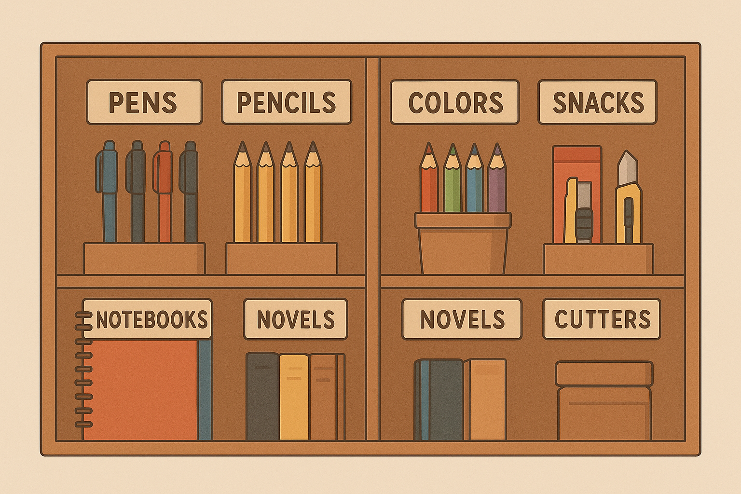
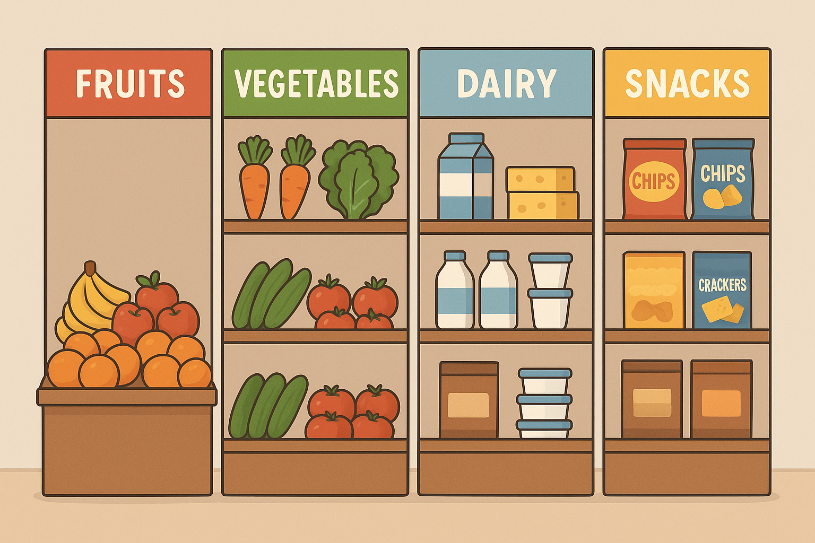
What is Clustering?
Clustering is a data analysis technique that groups similar data points together.
Each group (called a cluster) contains data points that are more similar to each other than to those in other groups.
It’s an unsupervised learning method, meaning it doesn’t rely on predefined labels or outcomes.
A Student bookshelf clustered based on the category of each product.
Helps businesses understand hidden patterns in customer data.
Enables personalized marketing strategies for each group.
Improves decision-making by identifying key customer segments (e.g., high spenders vs. budget buyers).
A Grocery store clustered based on the category of each product.

Slide 8
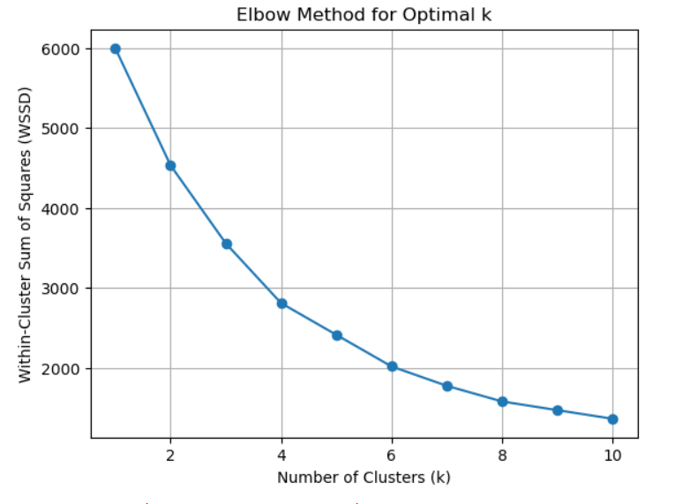
Clustering Process & Finding Optimal k
• Selected Age, Annual Income, Spending Score as key features
• Standardized data using Standard Scaler
• Applied K-Means clustering (k = 3)
• Used Elbow Method: WSSD vs k elbow at k = 3

Slide 9
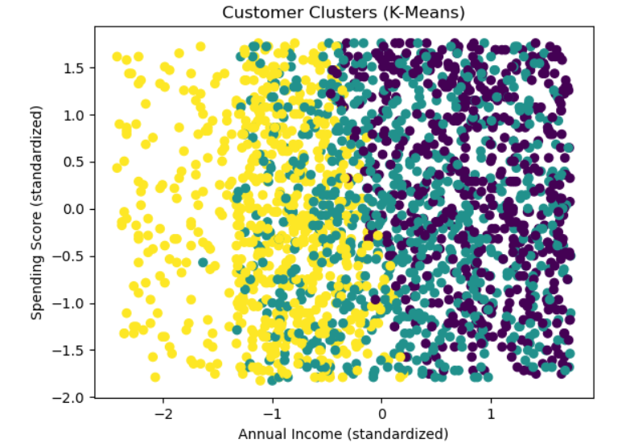
Cluster Insights & Target Segment
• Calculated average Age, Income, Spending Score for each cluster
• Compared cluster averages with overall means
• Cluster 0 showed highest spending score & strong income
• Target Segment: Young, high-income, high-spending customers

Slide 10
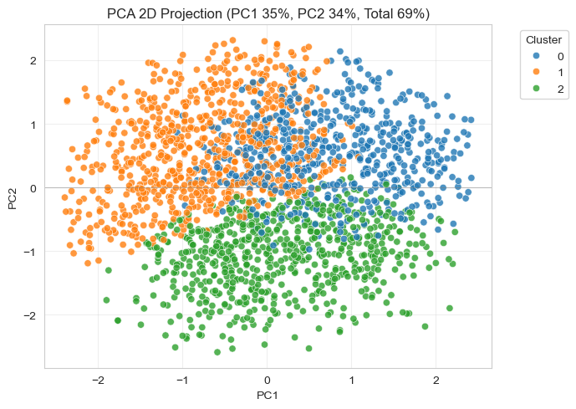
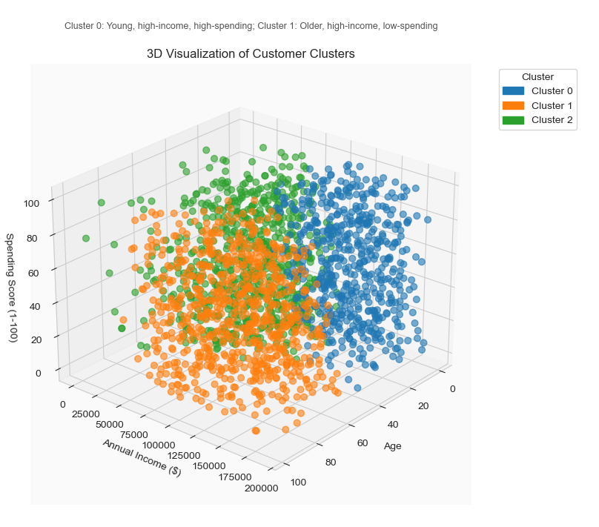
Visualization
Reveals cluster structure across Age, Income, Spending
Confirms clear cluster separation

Slide 11
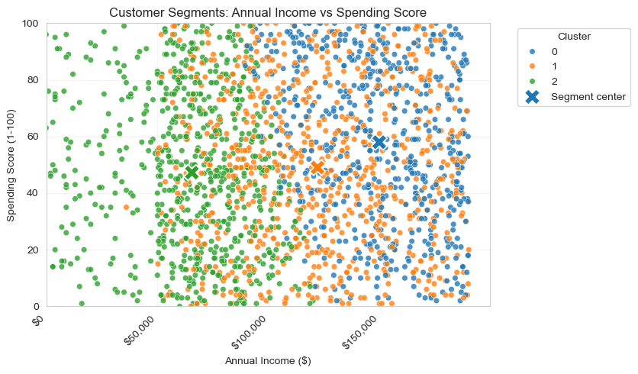
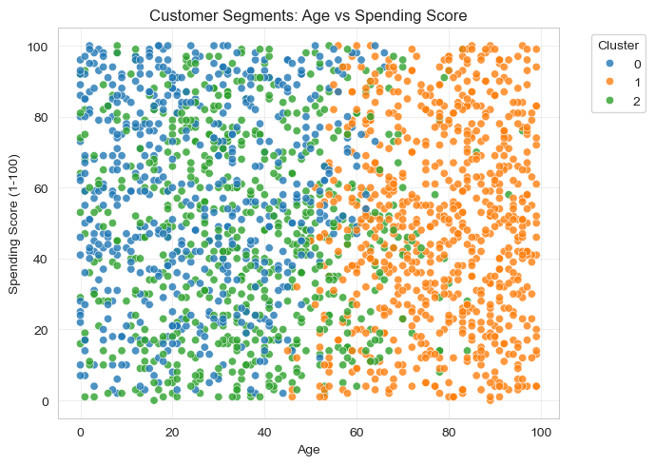
Younger customers tend to spend more
Highlights premium vs budget-conscious customers

Slide 12
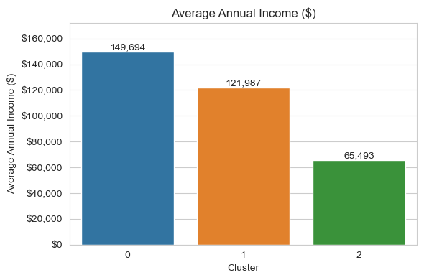
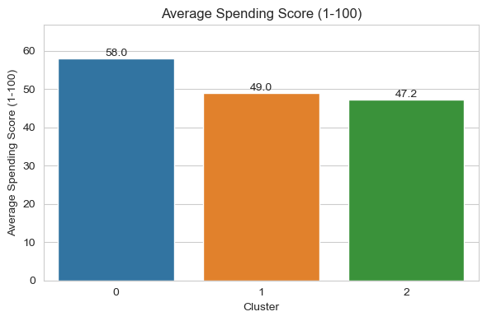
Cluster 0 highest
(the most valuable group)
represents young, high-income, high-spending customers

Slide 13
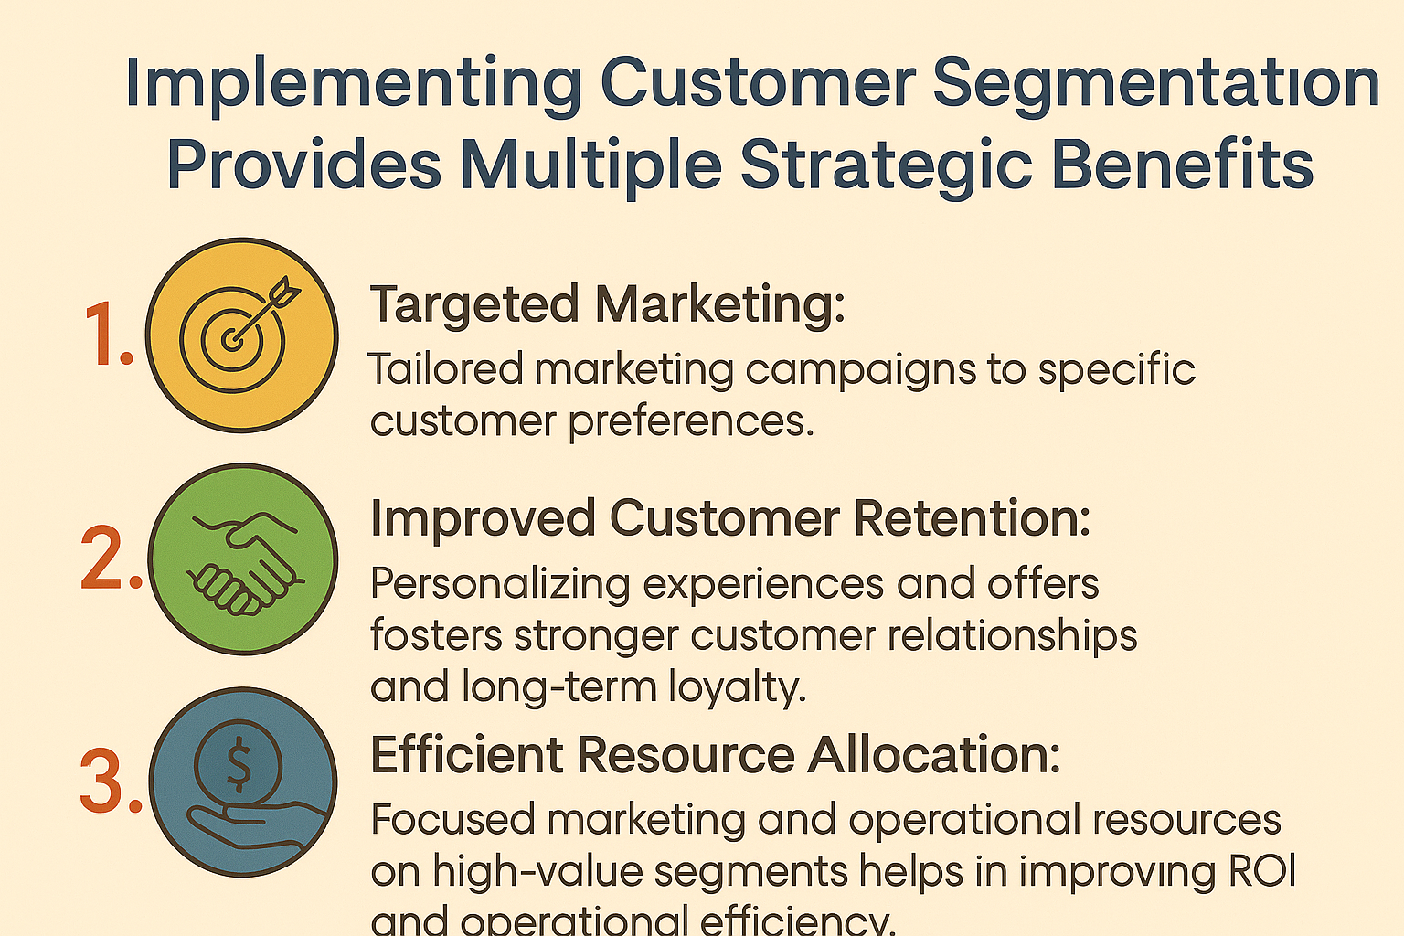
Conclusion & Business Value
Cluster 0 : identified as high-value customer segments that contribute significantly to revenue based on demographic and behavioral characteristics (e.g., income, spending habits, age groups).
Recognition of potential customer segments for targeted marketing campaigns.
Understanding of customer preferences and behaviors to improve product offerings, thereby improving customer engagement.

Slide 14
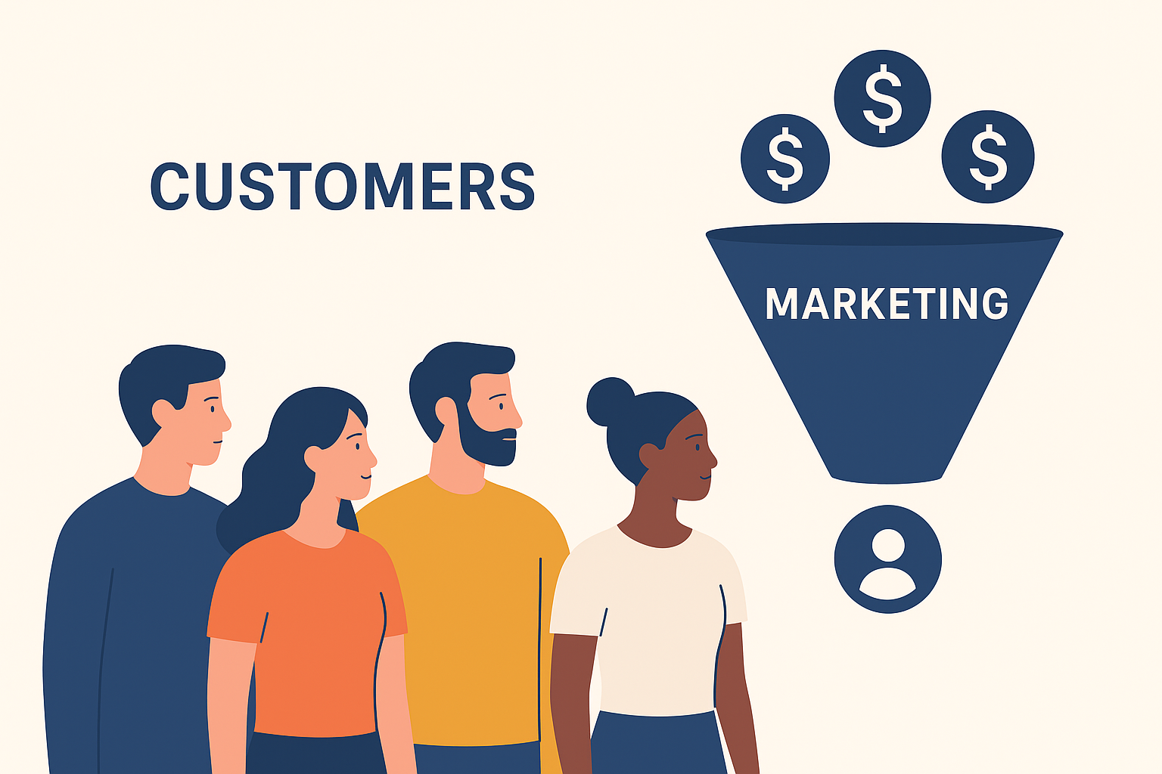
Impacts
Implementing customer segmentation provides multiple strategic benefits:
Targeted Marketing: Tailored marketing campaigns to customer preferences.
Improved Customer Retention: Personalizing experiences, stronger customer relationships and long-term loyalty.
Efficient Resource Allocation: Focused marketing and operational resources on high-value segments helps in improving ROI and operational efficiency.

Slide 15
Future Enhancements
Predict the Spending Score based on the customer's Age, Annual Income, and Work Experience.
Validate the Spending Score definition with stakeholders.
Compare results with Hierarchical or DBSCAN clustering.
Incorporate new behavioral variables for richer segmentation.

Slide 16
Thank you

